Slide 1
11-12. Combinational Logic circuit

Slide 2
outline
Combinational Logic Circuits Design: Designing combinational logic circuits, Exclusive OR and Exclusive NOR circuits, Logic circuits with multiple outputs, designing logic circuits without a truth table, Parity generator and checker circuit, Enable/Disable circuits, Programmable logic devices (PLD), Hardware description languages- HDL, VHDL.

Slide 3

Exclusive-or
Special logic circuit. Two types.
Exclusive-OR
Exclusive-NOR
Exclusive-OR: The circuit produces a HIGH output whenever the two inputs are at opposite levels. In other word, the output will be active HIGH only when a single input is HIGH. It’s abbreviation XOR. There are no three/four input XOR gate. The output expression of this circuit is $x=\overline{A}B+A\overline{B}$ .
Or $x=A⊕B$ where the symbol $⊕$ represents XOR gate operation.

Slide 4
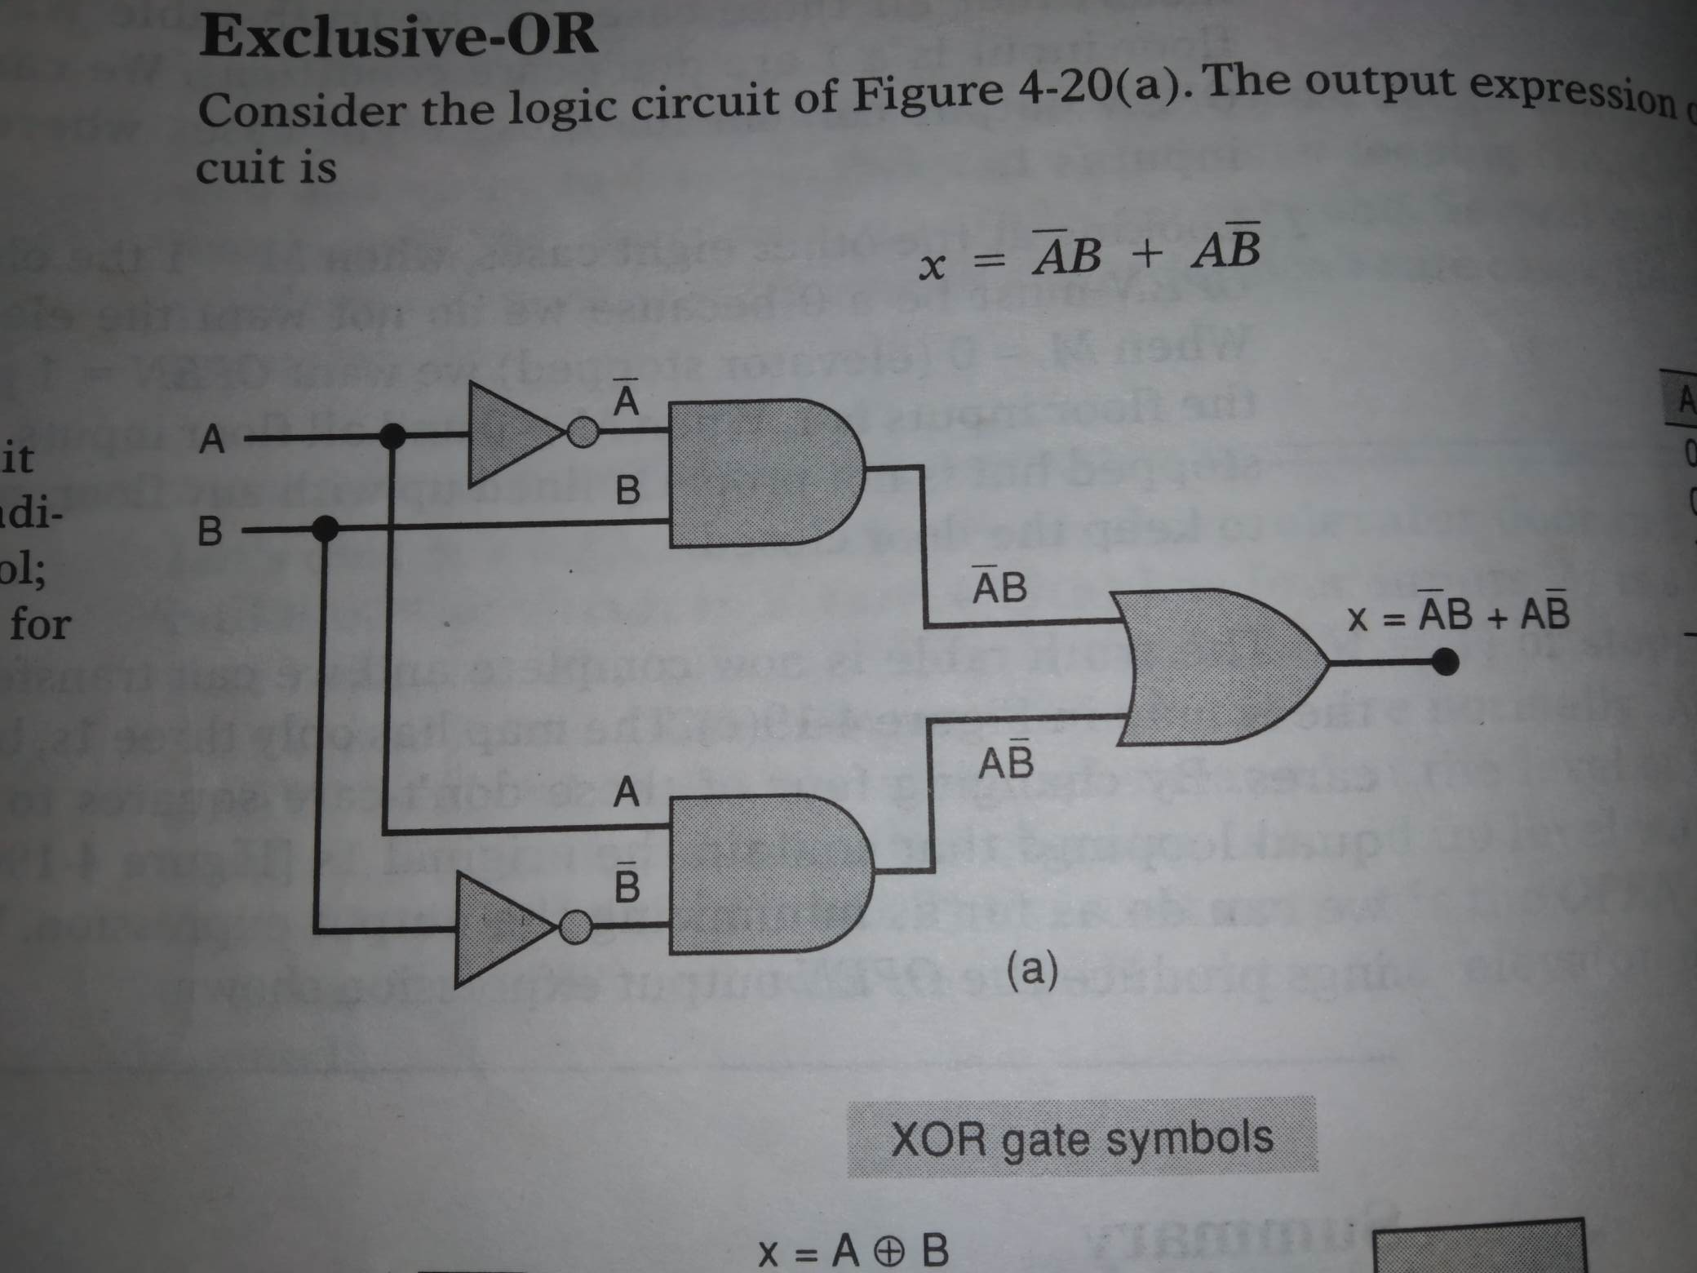
Exclusive-or

Slide 5
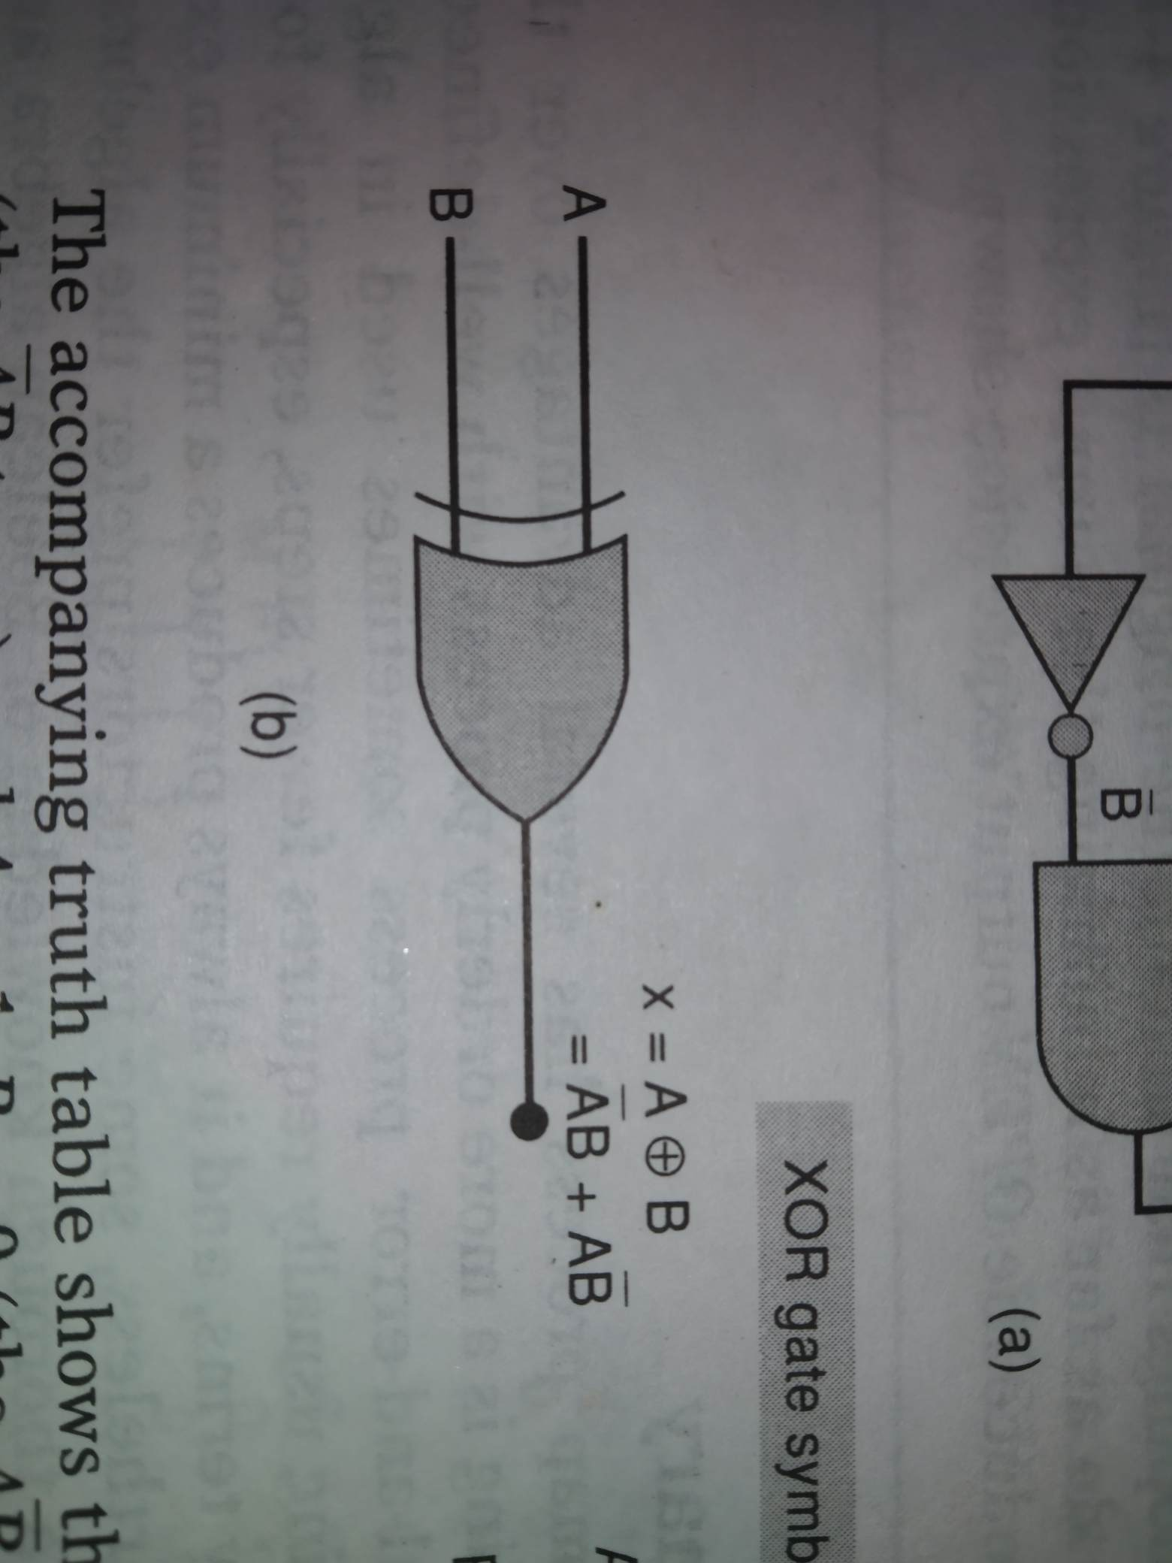
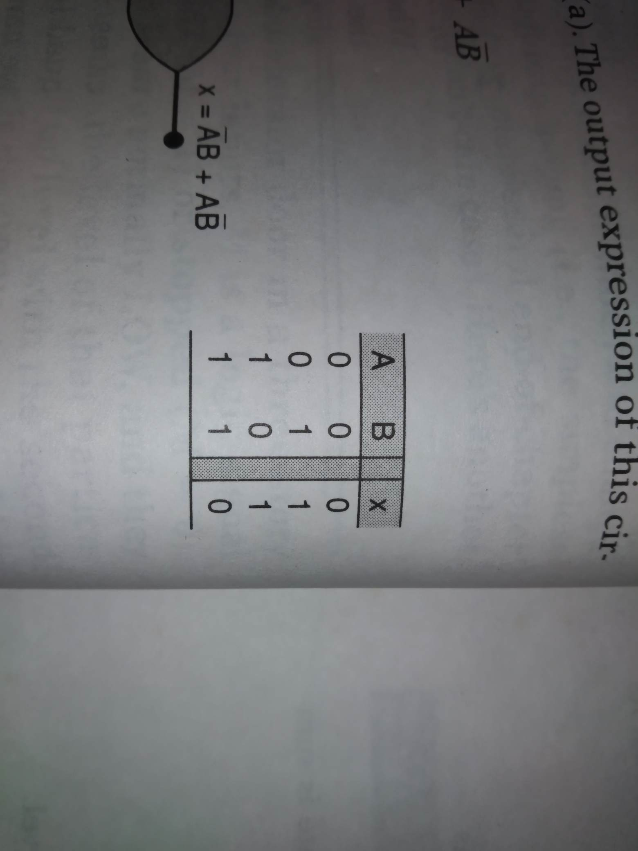
Symbol-truth table

Slide 6
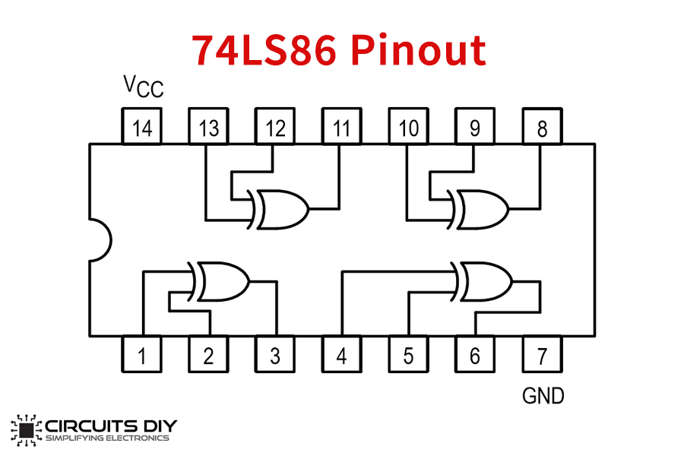
XOR IC
74LS86 – quad XOR (TTL family)
74C86 – quad XOR (CMOS family)
74HC86 – quad XOR (high speed CMOS)

Slide 7

Exclusive-nor
Exclusive-NOR circuit (abbreviation XNOR) operates opposite to the XOR circuit. The output expression is $x=AB+\overline{A}\overline{B}$
Or $x=\overline{A⊕B}$
XNOR produces HIGH output whenever the two inputs are at the same level. In other words XNOR output goes to its active LOW state when only one input is HIGH.

Slide 8
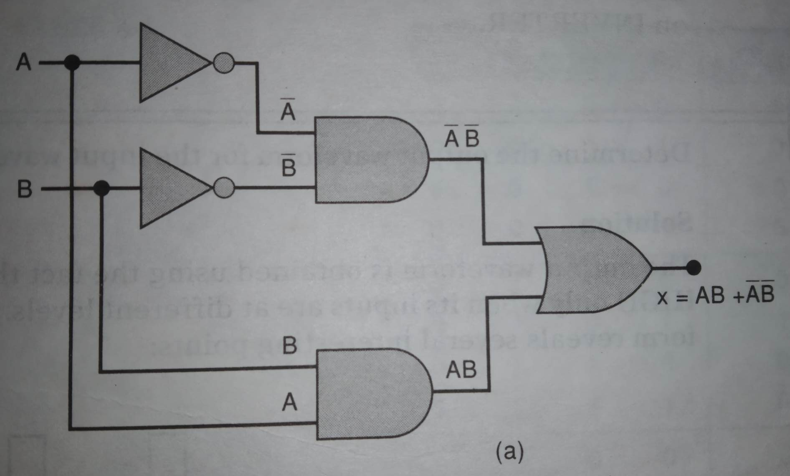
Exclusive nor

Slide 9
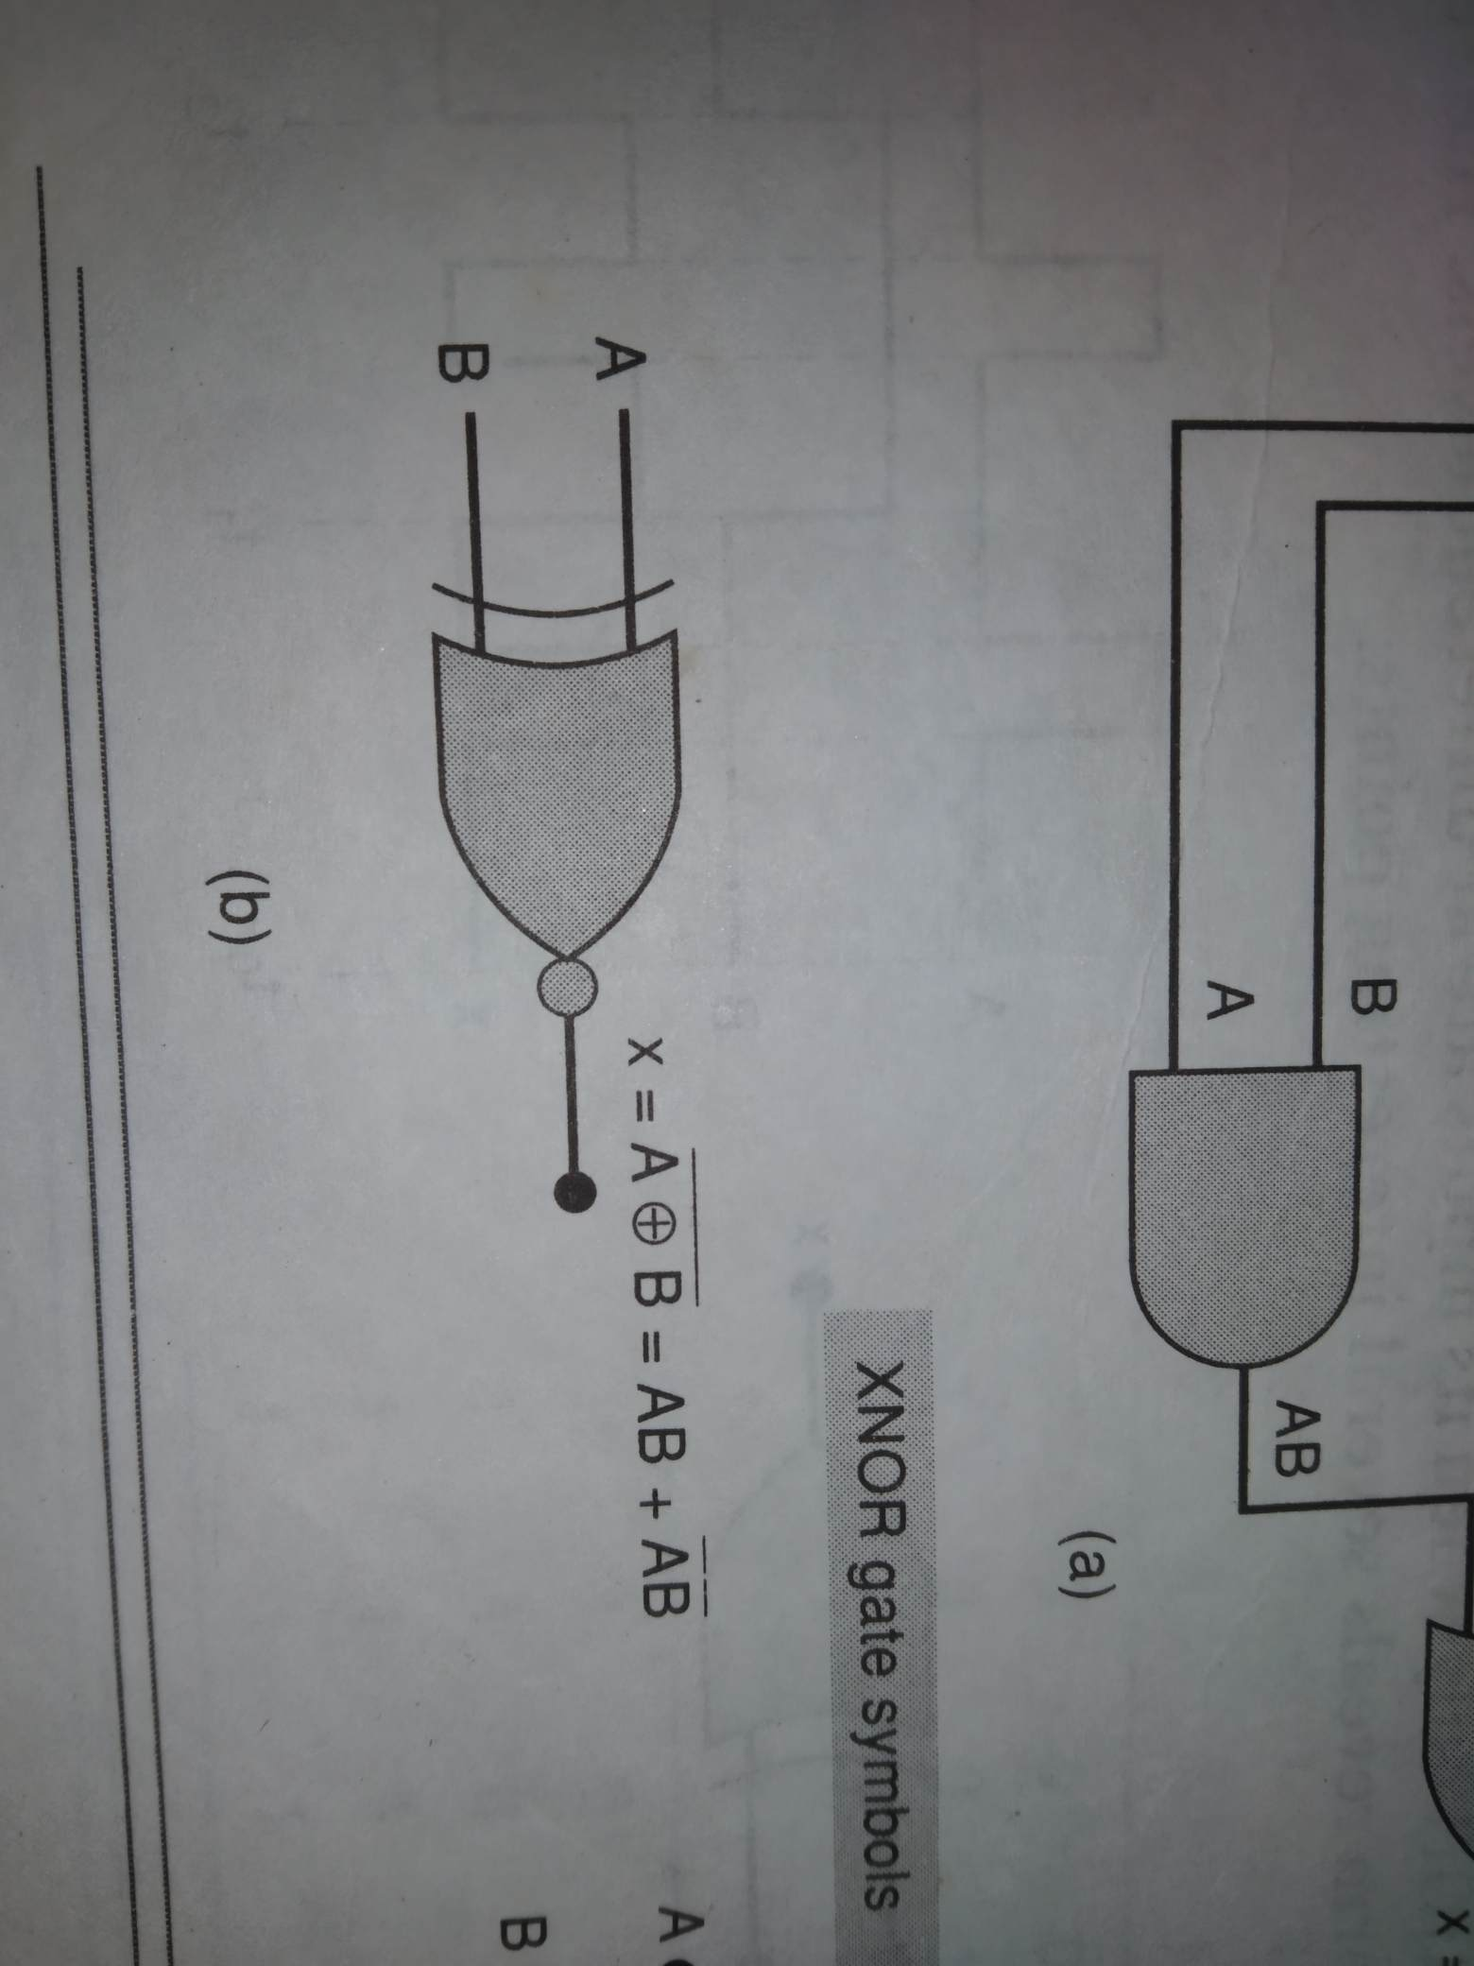
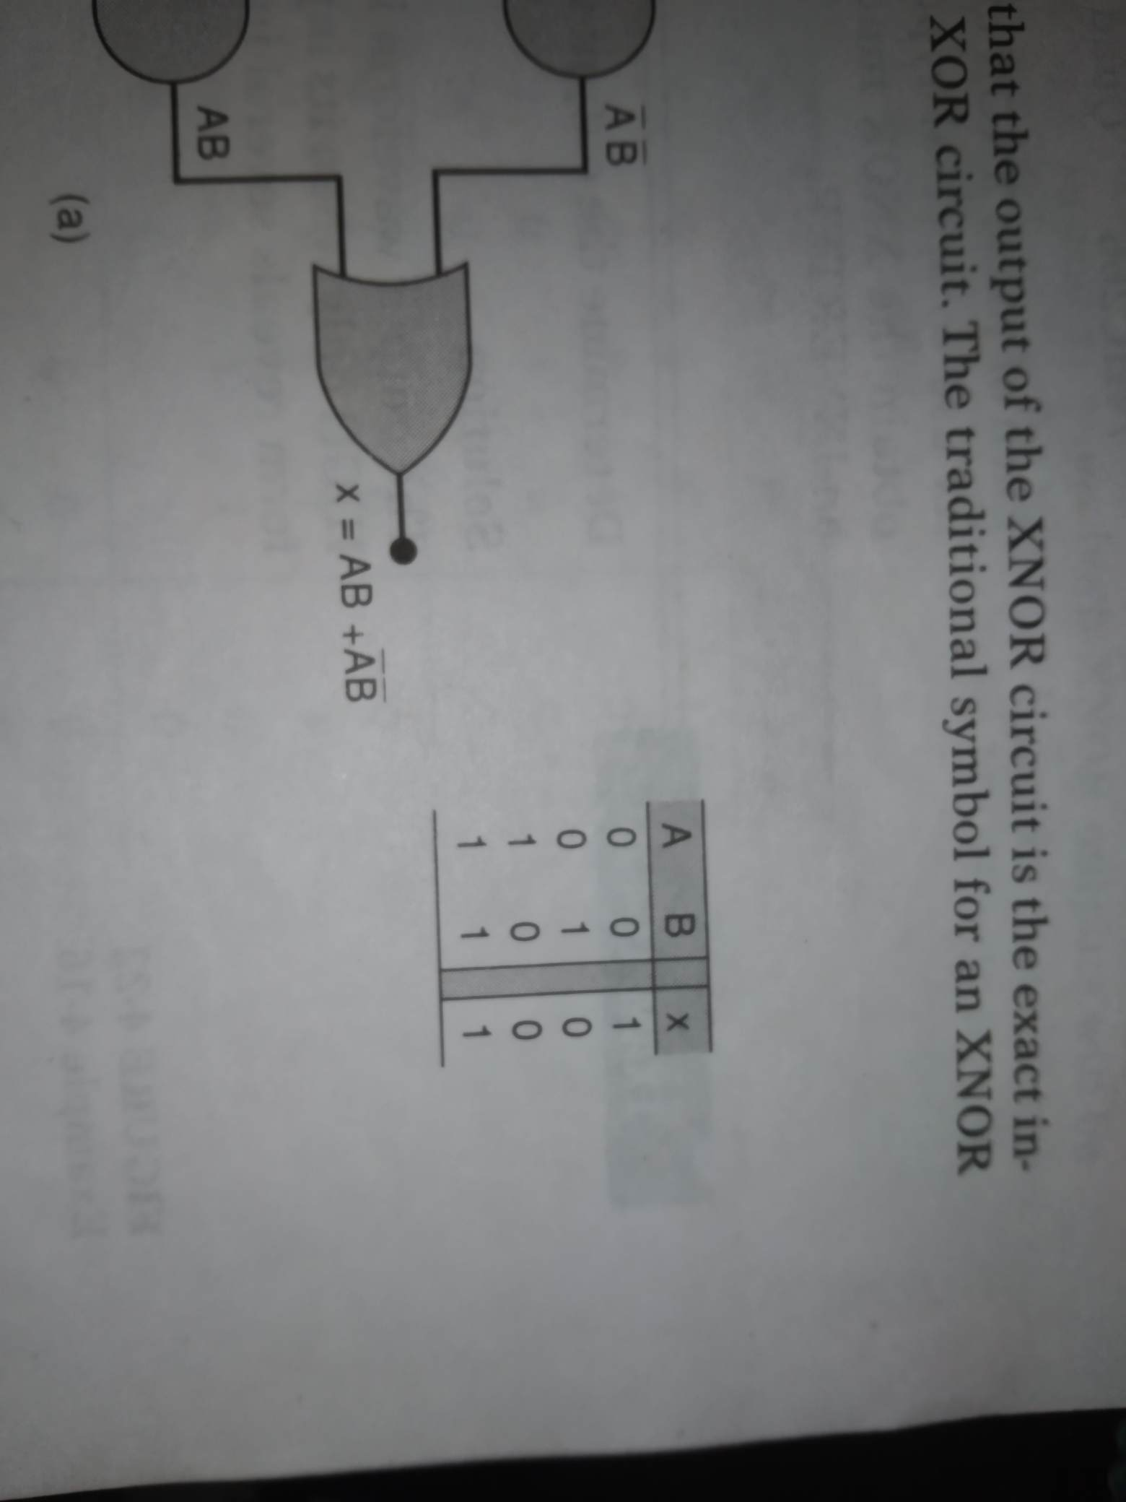
Symbol-truth table

Slide 10
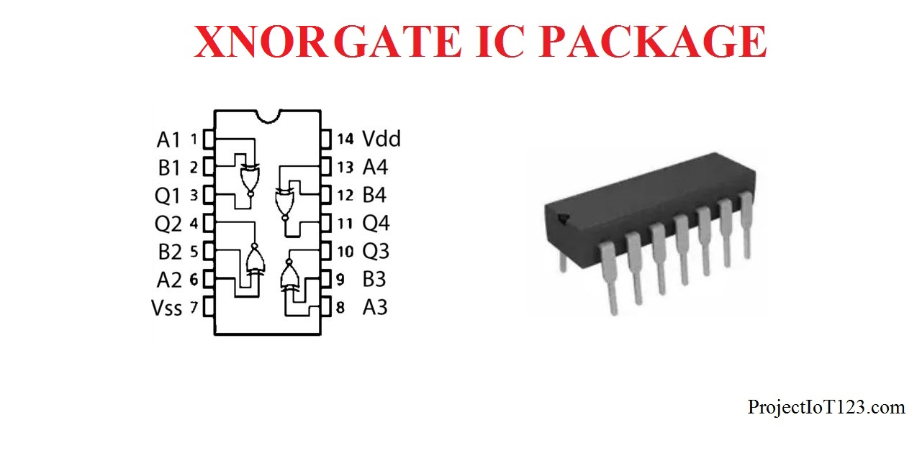
XNOR IC
74266 – quad XOR (TTL family)
4077 – quad XOR (CMOS family)

Slide 11
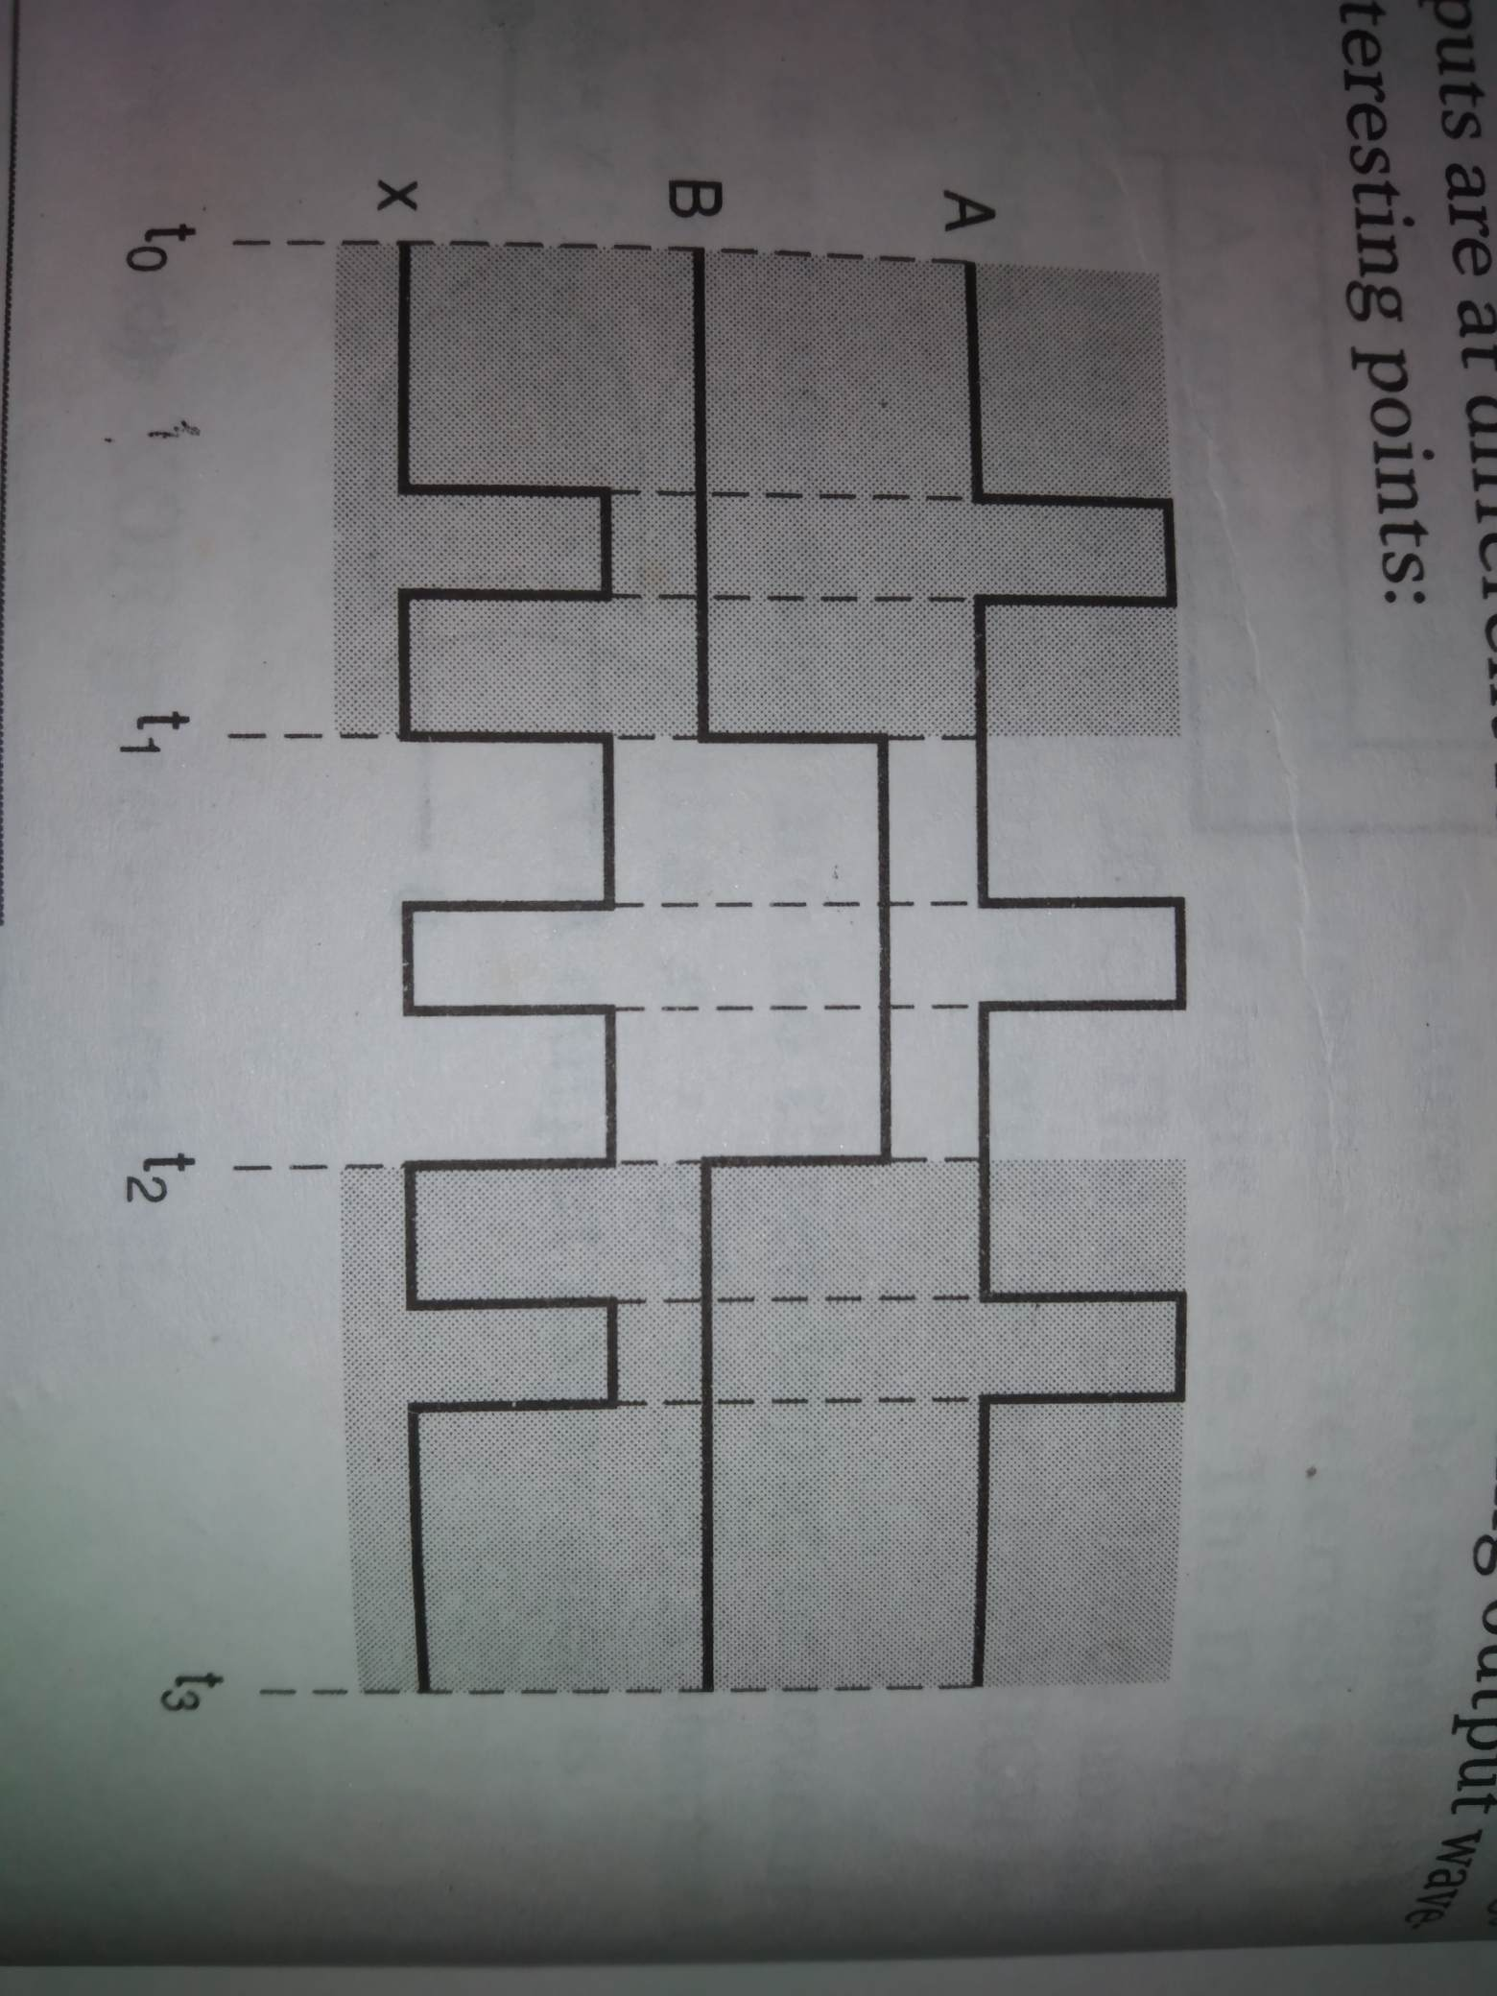
Output waveform of xor gate

Slide 12
Circuit for detecting equality of two two-bit binary numbers
If x1x0 represents a two-bit binary number and y1y0 represents another two-bit binary number then design a logic circuit using x1, x0, y1, y0 inputs whose output will be HIGH only when the two (two set of) binary numbers x1x0 and y1, y0 are equal.

Slide 13
x1 | x0 | y1 | y0 | z
0 | 0 | 0 | 0 | 1
0 | 0 | 0 | 1 | 0
0 | 0 | 1 | 0 | 0
0 | 0 | 1 | 1 | 0
0 | 1 | 0 | 0 | 0
0 | 1 | 0 | 1 | 1
0 | 1 | 1 | 0 | 0
0 | 1 | 1 | 1 | 0
1 | 0 | 0 | 0 | 0
1 | 0 | 0 | 1 | 0
1 | 0 | 1 | 0 | 1
1 | 0 | 1 | 1 | 0
1 | 1 | 0 | 0 | 0
1 | 1 | 0 | 1 | 0
1 | 1 | 1 | 0 | 0
1 | 1 | 1 | 1 | 1

Slide 14
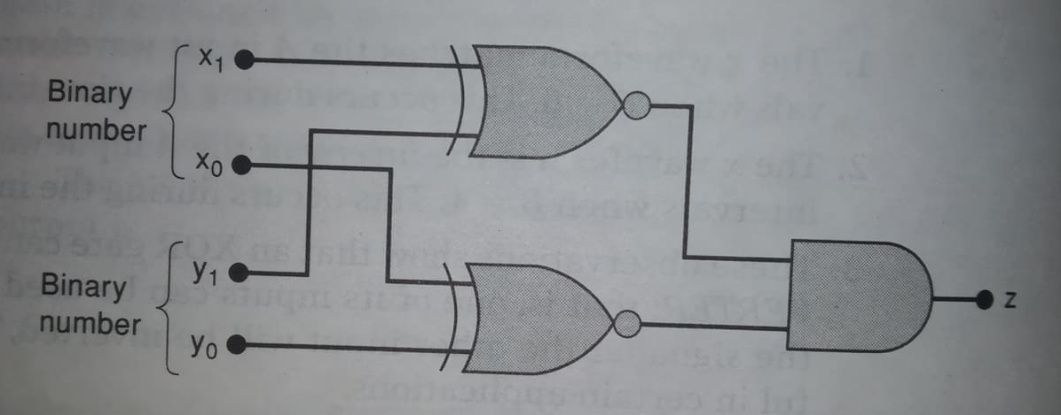
Circuit for detecting equality of two two-bit binary numbers

Slide 15
Parity generator and checker

Slide 16
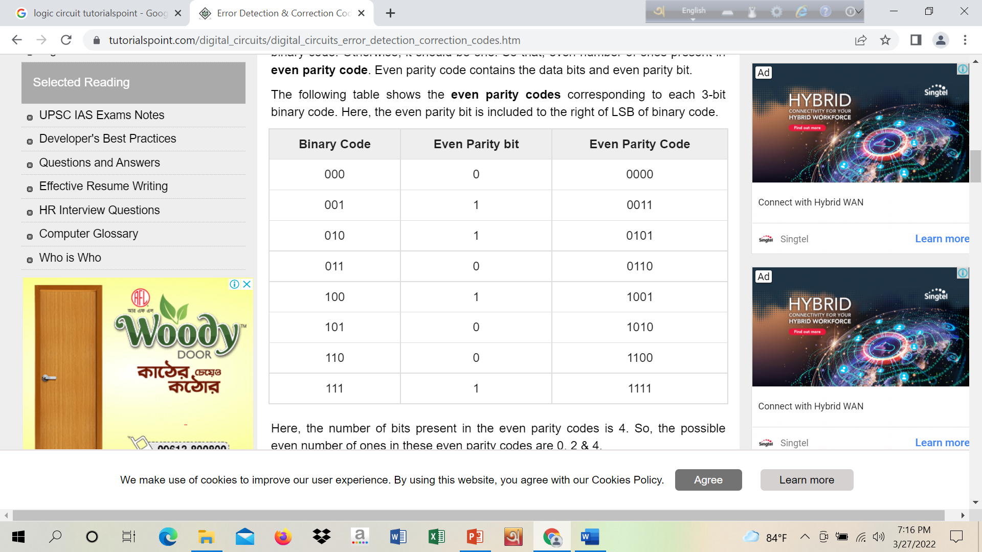
RECAP lecture 1-2 (3): Even parity code
The following table shows the even parity codes corresponding to each 3-bit binary code. Here, the even parity bit is included to the right of LSB of binary code

Slide 17
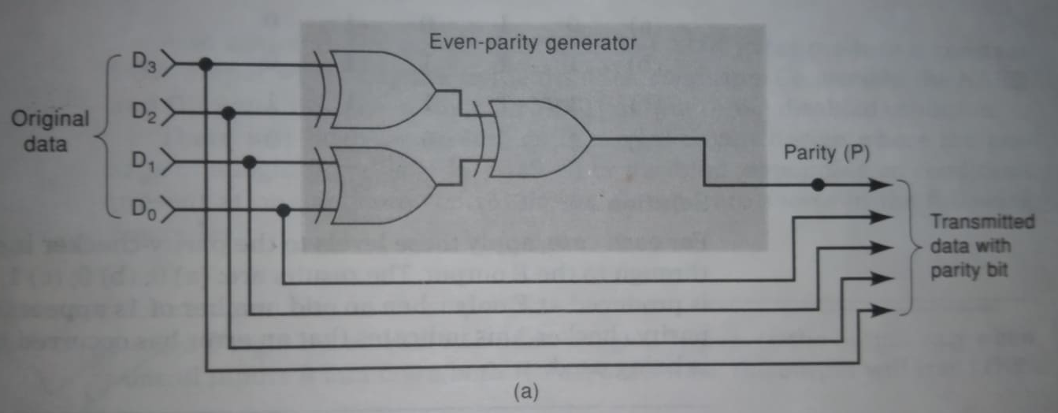
Even parity generator logic circuit
1
1
0
0
1
0
1

Slide 18
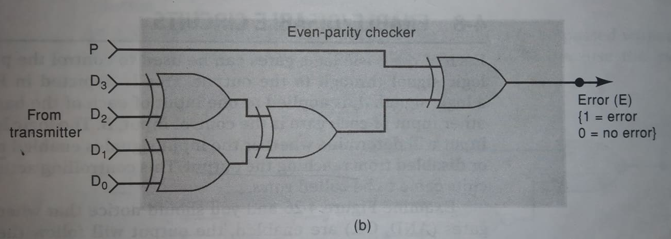
Even parity checker
0
1
1
0
1
1
1
1
0

Slide 19
Problem-solution
Determine the parity generator’s output for each of the following sets of input data D3 D2 D1 D0 (a)0111 (b)1001 (c) 0000 (d)0100.
1
0
0
1

Slide 20
Problem-solution
Determine the parity checker’s output for the following sets of data P D3 D2 D1 D0 (a)01010 (b)11110 (c) 11111 (d)10000.
0
0
1
1

Slide 21
Enable/disable circuits

Slide 22
Enable/disable circuits
Following figure shows logic gates, where one input is logic signal/input and another input is control signal/input. Control input is determine whether the input signal is enabled to reach the output or disabled from reaching the output.

Slide 23
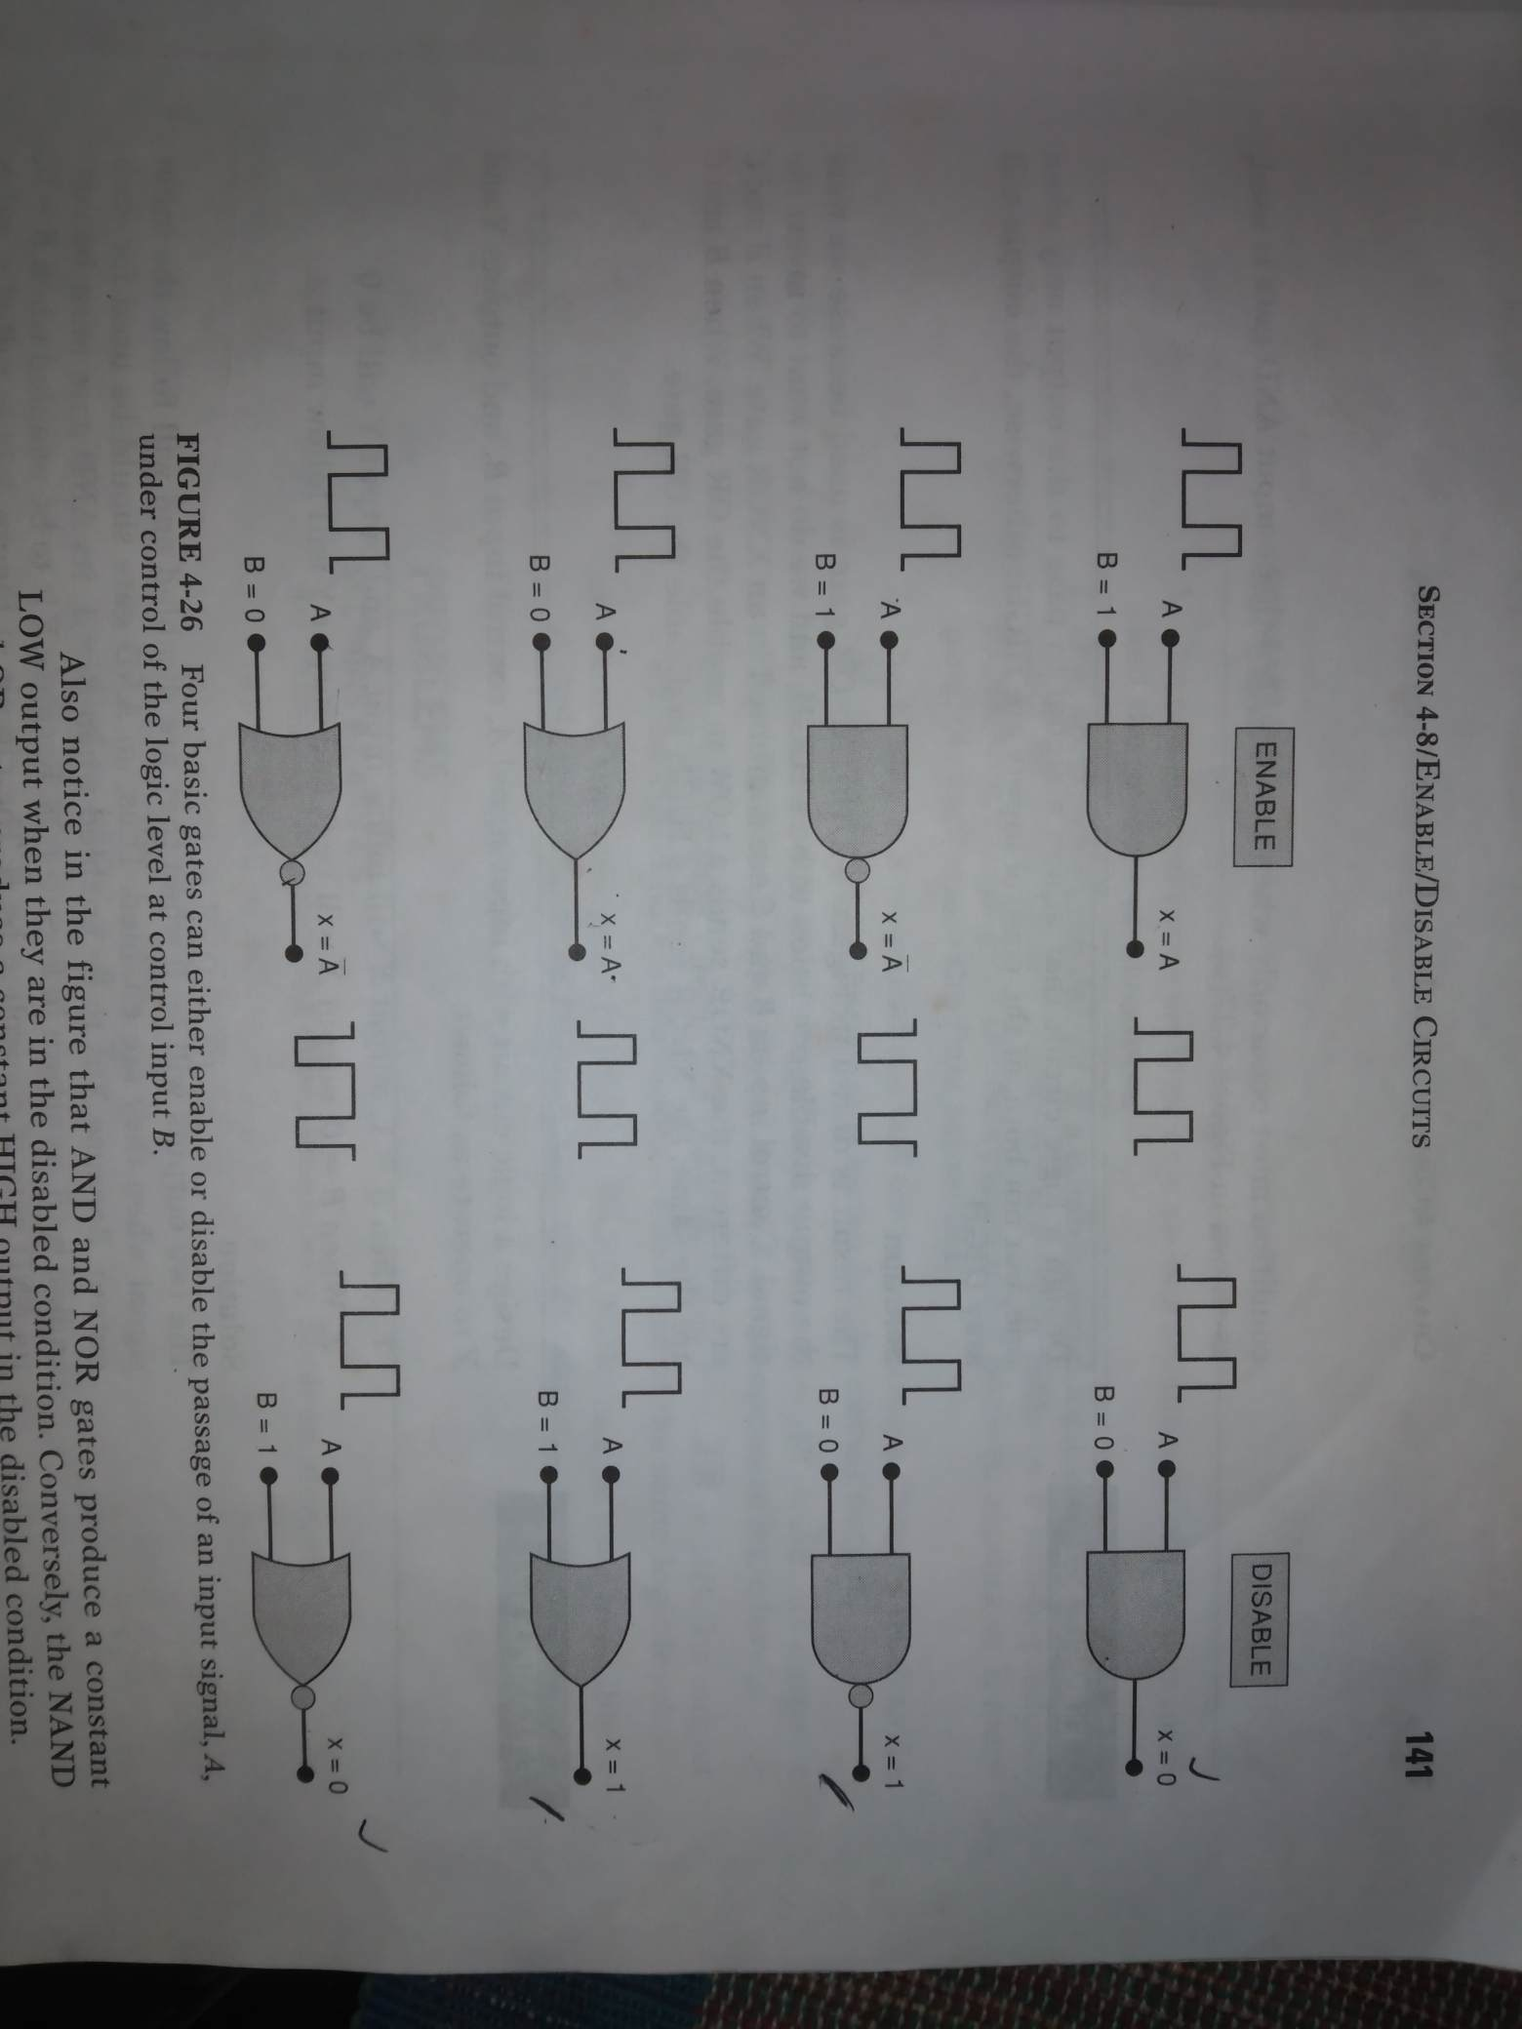

Slide 24
Problem-solution
Design a logic circuit that will allow a signal to pass to the output only when control inputs B and C are both HIGH, otherwise the output will stay LOW.

Slide 25
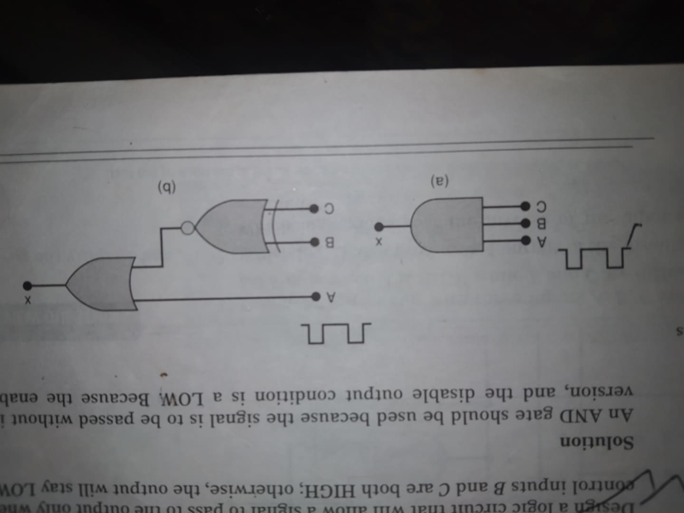
Problem-solution
1 (a)

Slide 26
Problem-solution
Design a logic circuit that allows a signal to pass to the output only when one, but not both of the control inputs B and C are HIGH, otherwise the output will stay HIGH.

Slide 27
Problem-solution
3 (a)

Slide 28
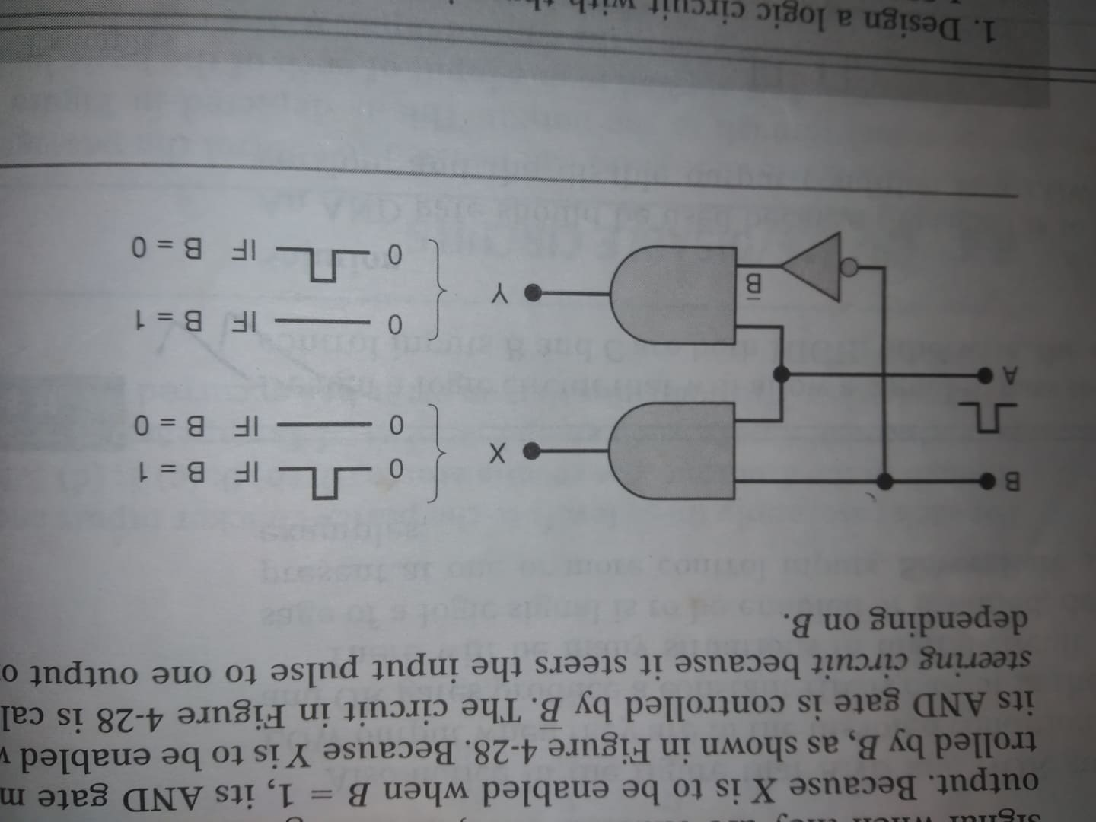
Problem-solution

Slide 29
13. Logic circuit description using hardware description languages (HDL)

Slide 30
HDL
To describe a logic circuit- various methods are Boolean algebra/ mathematical tool, truth table/ data organization tool, symbol/ drawing tool, timing diagram (waveform)/ graphical tool. Any of these tools can be used to provide input to computers.
Other tool/ convenient tool/ most powerful tool is language. It is called hardware description language (HDL). Very high speed integrated circuit (VHSIC) hardware description language (VHDL).

Slide 31
HDL vs programming language
The languages used in HDL are very similar to languages that describe computer programs (BASIC, C, JAVA). But the resulting implementation operates quite differently. Knowledge of any of these computer programming languages is not necessary to understand HDL. The important thing is that when you have learned both an HDL and a computer language, you must understand their different roles in digital systems.

Slide 32
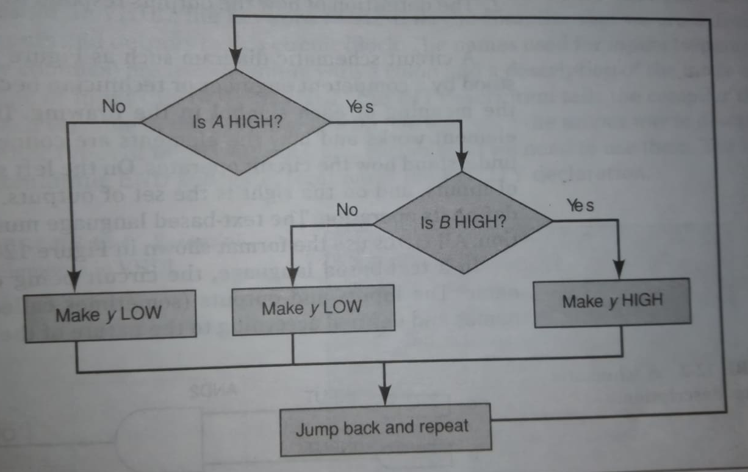

Design process of computer program
$$y=AB$$

Slide 33
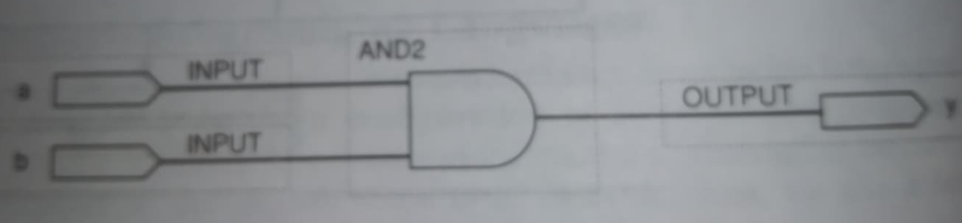

HDL/ VHDL format and Syntax
Basic format of HDL/VHDL involves two elements.
1. The definition of what goes into it and what comes out of it (input, output).
2. The definition of how the outputs respond to the inputs (operation). A schematic diagram description is shown below.
$$y=ab$$

Slide 34
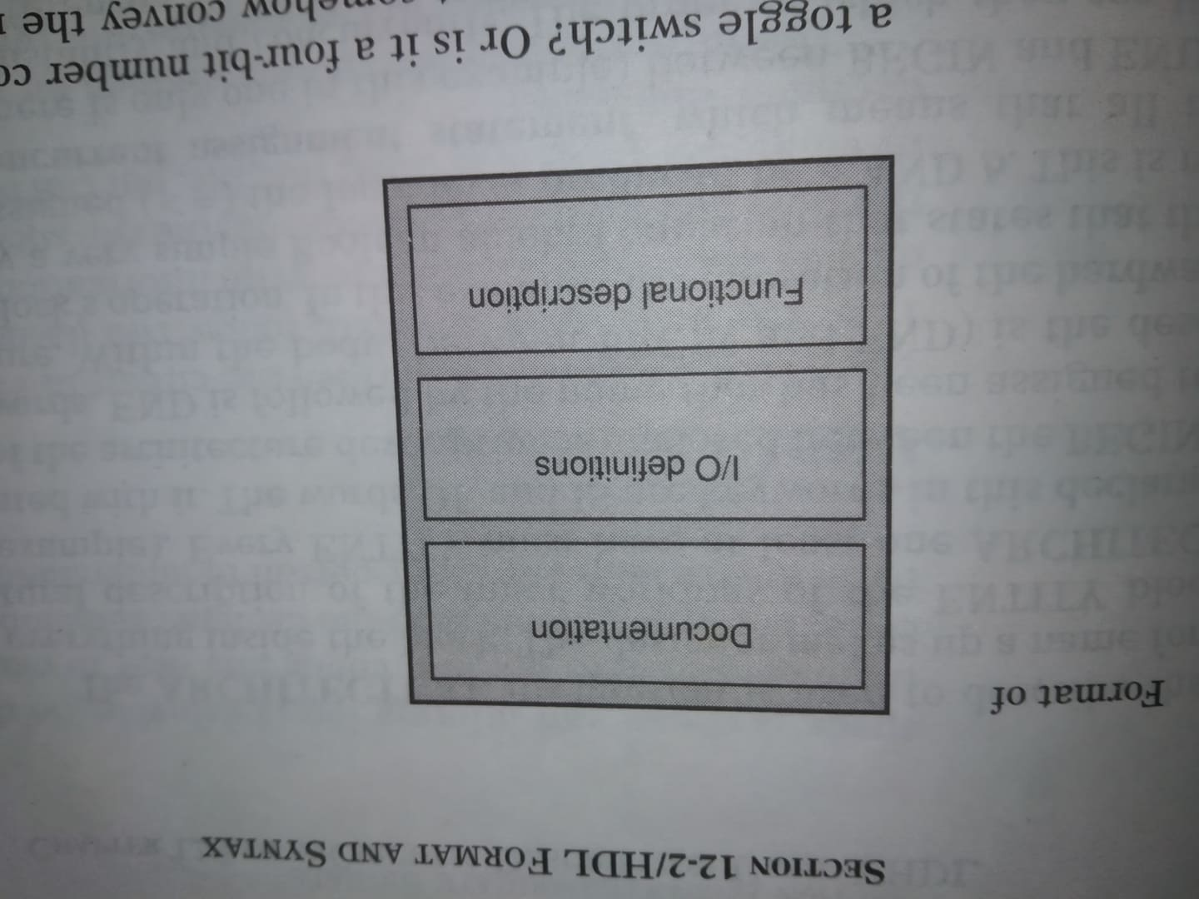
HDL/ VHDL format and SYNtax
The definition of the circuit’s operation in a text based language is contained in a set of statements that follow the circuit input/output (I/O) definition.

Slide 35
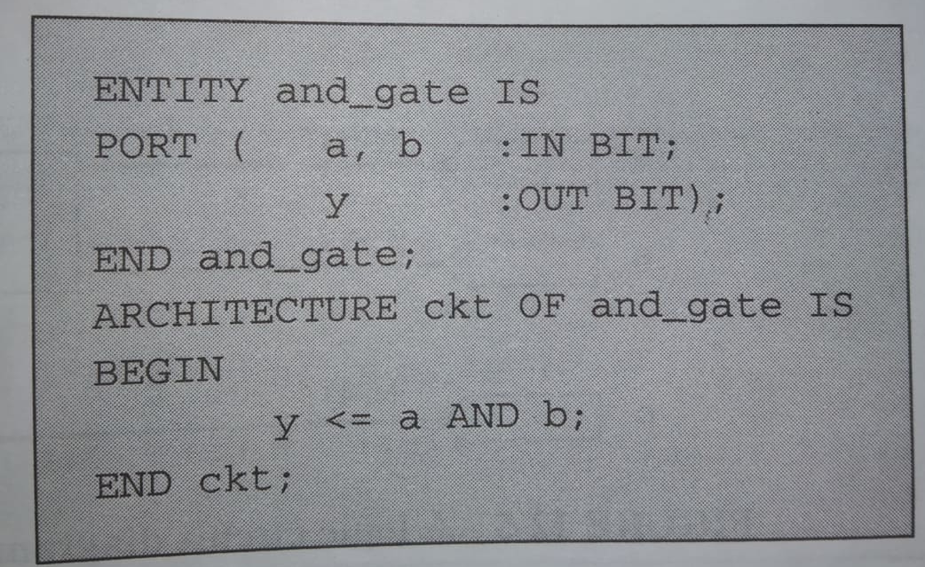
Elements in VHDL

Slide 36
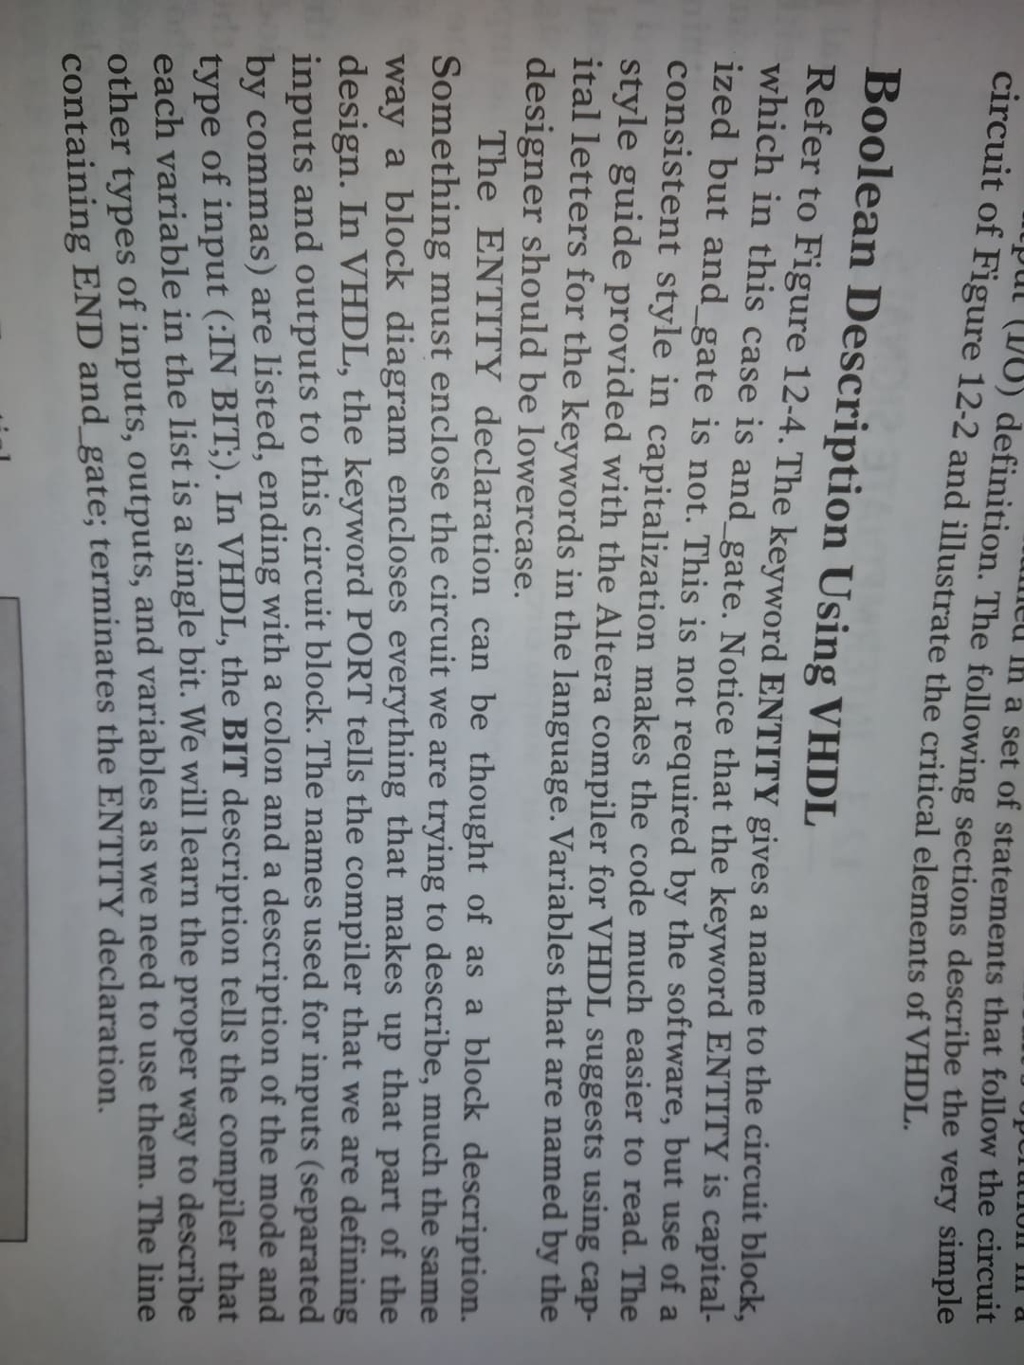
Boolean description using VHDL

Slide 37
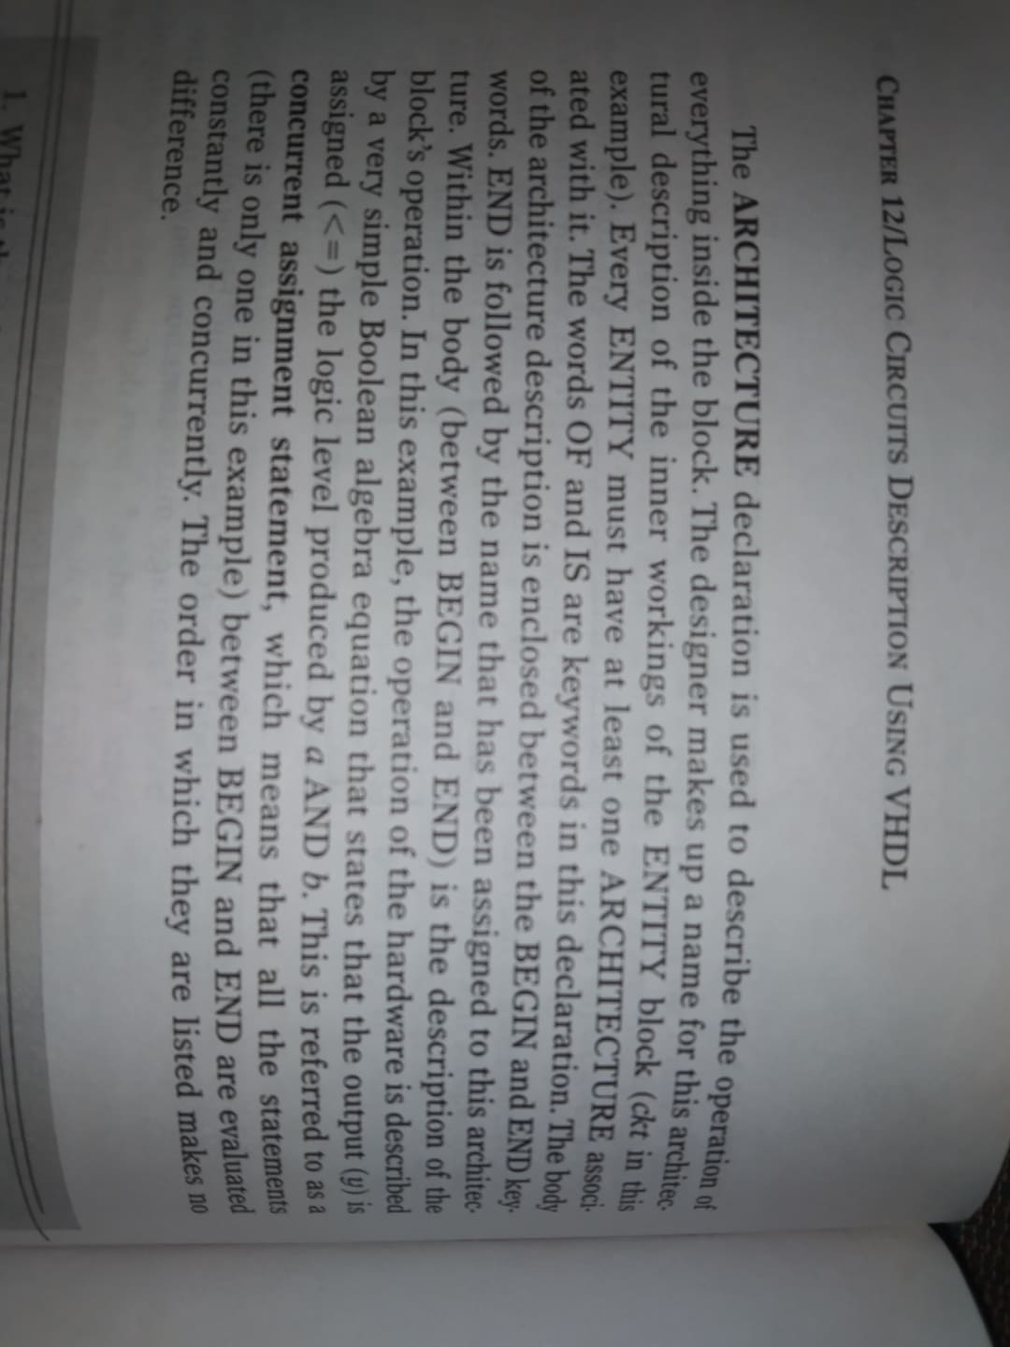
Boolean description using VHDL

Slide 38
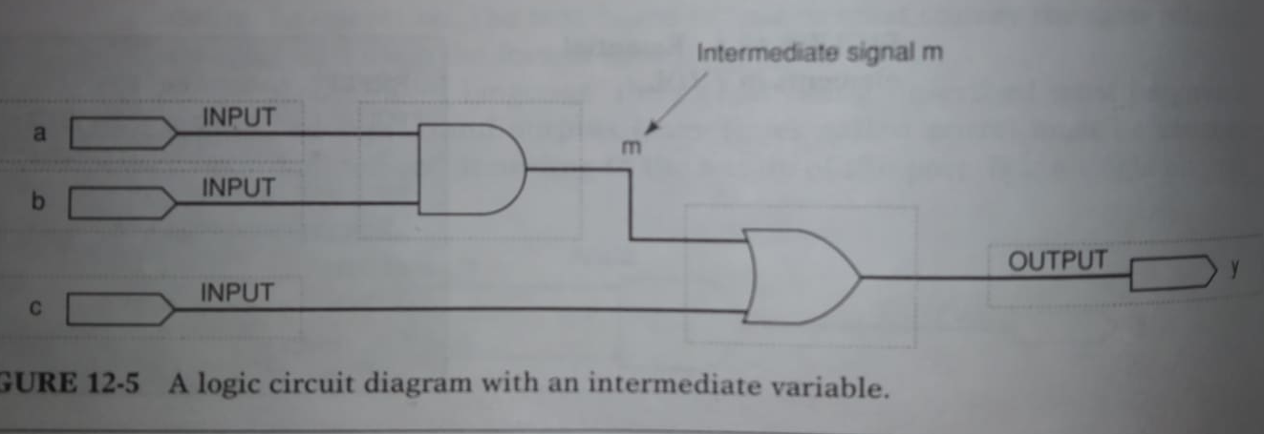
Schematic diagram

Slide 39
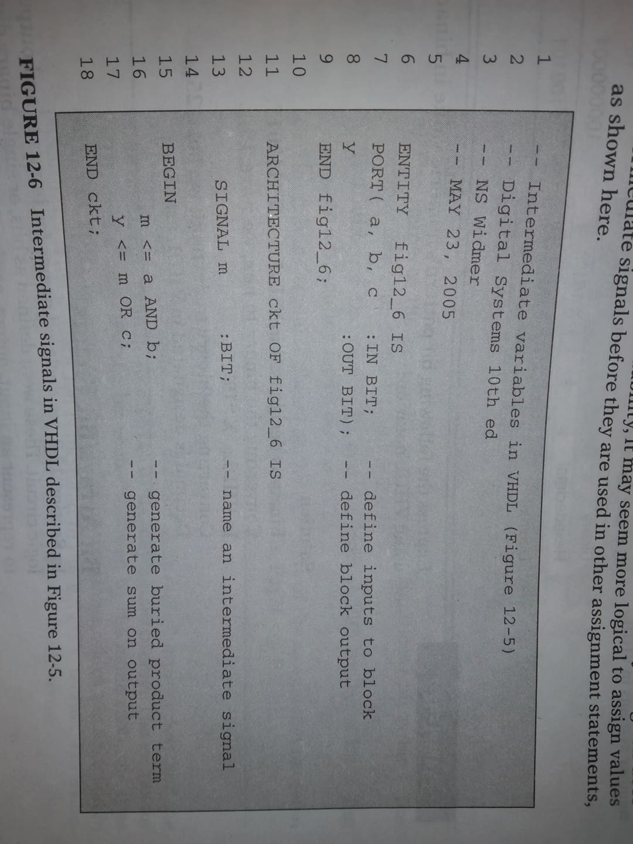
Boolean description using VHDL

